Slide 1
Lecture
Excel: Counting &
Conditional Functions

Slide 2
Counting Cells
Count:
Number of non-blank, non-text cells
CountA: Non-blank cells
CountBlank: Counts blank cells
CountIF: Based on criteria

Slide 3
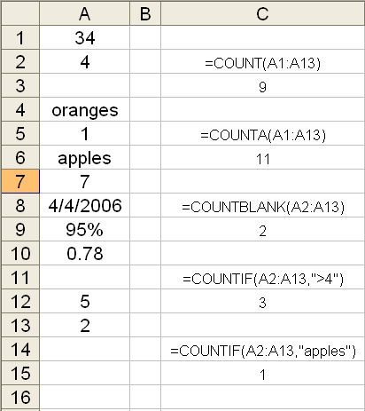
Count Examples

Slide 4
Conditional Function - IF
Used to make a decision in a spreadsheet, to display one value or another
If “this is true”, then “do this”, else “do that”
Like BASIC programming: IF, THEN, ELSE
Syntax:
  =IF(test, true, false)

Slide 5
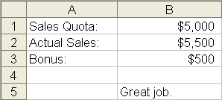
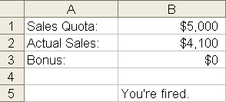
IF in Action
=IF(B2<B1,0,500)
=IF(B2<B1,"You're fired.","Great job.")

Slide 6
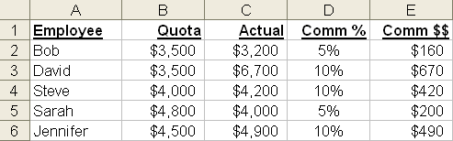

More IF…
=IF(C2>B2,$B$8,$B$7)
Always try and use cell addresses on formulas, rather than raw values
=IF(C2>B2,10%,5%)

Slide 7
Syntax
Syntax:
  =IF(test, true, false)
A test is a comparison between cells, text, or numbers
True and False values can be a cell, text, a number or even a formula!

Slide 8
And, Or
OR
  =IF(OR(test,test), true, false)
AND
  =IF(AND(test,test), true, false)

Slide 9
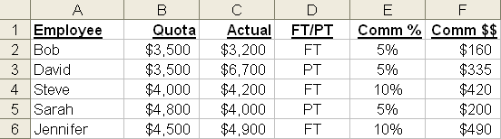
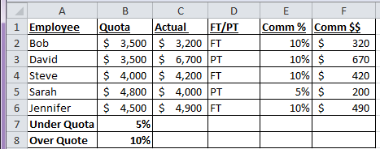
AND/OR in Action
=IF(AND(C2>B2,D2="FT"),$B$8,$B$7)
=IF(OR(C2>B2,D2="FT"),$B$8,$B$7)

Slide 10
Sum and SumIF
Sum: Adds up values.
SumIf: Adds values only if they meet criteria

Slide 11
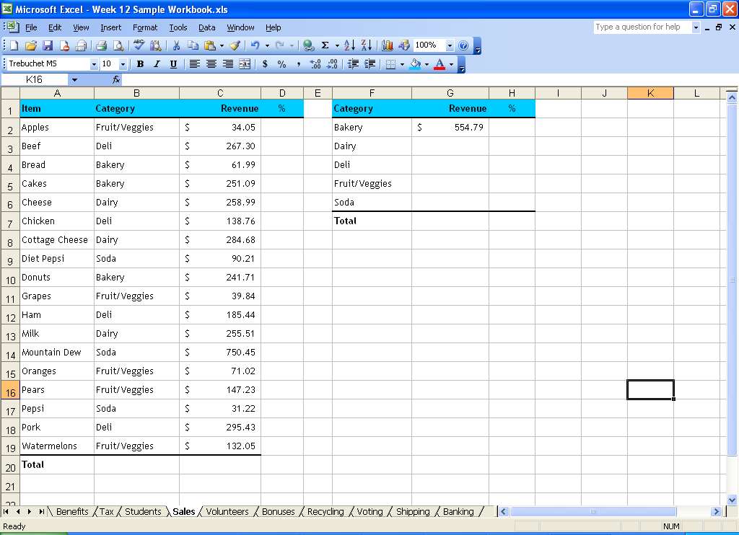
SumIF Example
=SUMIF(B2:B19,"Bakery",C2:C19)

Slide 12
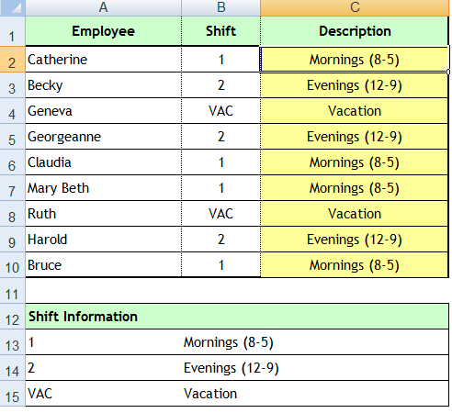
Nested IF Statement
Nested if statements are nothing but using an if statement inside another if statement when you have multiple logical tests.
“If it’s raining, take an umbrella, but if it’s foggy, wear a coat, but if it’s windy wear a hat, or else stay home”
Be sure to have as many closing ))) parentheses as you have IF statements
=IF(B2=$A$13,$B$13,IF(B2=$A$14,$B$14,IF(B2=$A$15,$B$15,”Not Working)))

